Slide 1
Digital Transformation in Agriculture

Slide 2
Indian Agricultural Sector
Food grain surplus yet high wastage.
80% of the population lives in rural areas and depends on agricultural production.
Urgent need to diversify agriculture to address emerging food demands and habits, and dietary problems.
Need for climate smart agri-technologies to tackle climate change issues.
Opportunities to improve productivity along value chain.
Increased presence of private sector in both input and output markets.
Need to produce both economically efficient & environmentally friendly technologies to tap the opportunities for export.
Notes:
Key features of India agricultural sector
Significant productivity advances in main food staple, but accompanied by large food surplus in recent years – 29 million tones for rice alone
Agricultural production characterized by predominately small holder production system. Couple with a large rural population of approximately 750,000 million people most of who are dependant on agriculture production and employment.
One of the largest concentrations of agricultural and food scientists in the world, including in advanced scientific areas. Complementary scientific and management expertise held in a large number of world class organization in India
A large domestic market for agricultural produce and following liberalization, opportunities for produce export.
Agricultural sector well integrated in market economic. High demand for purchased inputs- seed, pest management inputs.
A well advanced economic liberalization programme with very attractive opportunities emerging for the private sector in both input and output markets.
A emergent vertically integrated food industry offering the opportunity to more efficiently link primary producers to consumers via private industry. Related food habit changes in urban sector towards proceed convenience foods.
A well established private seed industry, with many large companies investing in R&D.
A nascent private biotechnology industry in the health and agricultural sectors. Complementary capacities in information technology provide a potential comparative advantage in bio-informatics.

Slide 3
Agriculture is a risky enterprise – can digital help
Agriculture Risk
Production Risk
Weather
Labour
Post Harvest Risks
Storage
Knowledge
Quality Inputs
Market Risk
Market Information
Access to Credit
Access to
Market
Price Volatility
Ecological Risk
Limited Land
Limited Water
Climate Change will cause more uncertainty
Mechanization mitigates labour shortage but funding is constrained.
Traditional Agriculture extension systems are inadequate and lack depth to help farmers deal with exigencies like pests, disease etc
Timely access to quality seeds and fertilizers is still unreliable
Most farmers lack access to structured credit markets making them a prey for the money lenders
India loses about one third farm produce for want of quality storage
High levels of Information asymmetry due to variety of reasons
Access to markets is still a challenge due to high transportation costs
Price Volatility tends to benefit only speculators
Rapidly degrading land and soil health pose a challenge to ecology and future productivity.
Declining Ground water table and erratic rainfall poses a serious challenge to reliable source of water for irrigation
Digital tools offer pathways to mitigate agriculture risk

Slide 4
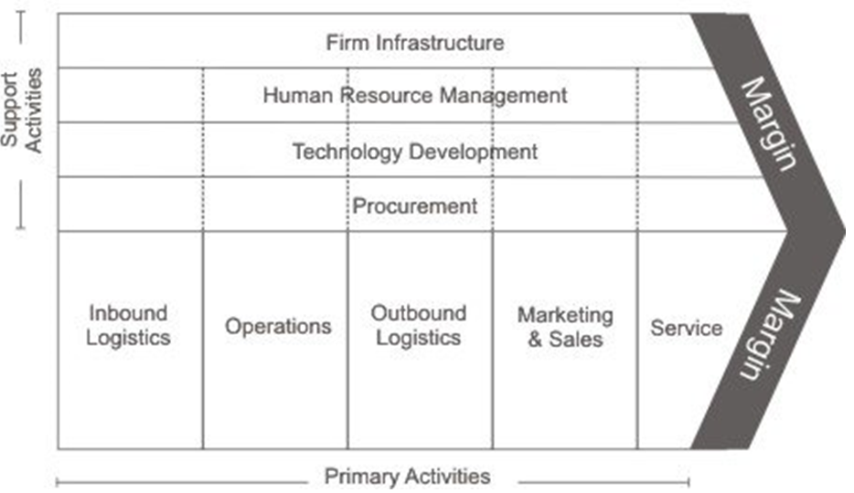
Porter’s Value Chain Framework
Land, Water, Machinery, etc
Corporate success driven by linkages
Linkages are about seamless cooperation and information flow
Most often, an ecosystem of companies works across the value chain
Challenges for farm as an ag enterprise
All primary value chain activities other than operations are dispersed across public and private institutions
This leads to a weak bargaining position
Many variables within operations/production Eg. Weather
Technology Development/R&D mostly through public institutions
Self, Family, Farm Labour
SAUs, Public Institutions, private sector
Govts, Agriculture Dept
Competitive Advantage by Porter (1985)
Farmer
Private Sector
Research
Government
Consumers

Slide 5
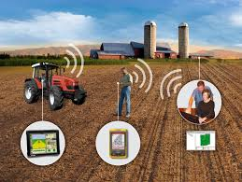
Canvas for ICTs 4 Ag
Peer to Peer collaboration platforms
Information Extension
Learning platforms
FPO management software
Farmers2Consumers (F2C)
Research2Farmer (R2F)
Lot of ICT innovation
Market linkages is a very broad term – processor, aggregator, retailer, end customer
New business models emerging – ICT is a critical enabler
Extension Systems
KVKs
NGOs
Ag Marketing Structures
Knowledge Intermediaries
Government2Farmer (G2F)
Distribution Channels
Government Departments
Federal vs State
Multiple Departments
Subsidies
Private2Farmer (P2F)
Mostly input companies – fertilizers, seed, pesticides companies
ICT enabled innovation
happening -Evolutionary
& revolutionary
Knowledge seen as a means to build customer loyalty
Operations
Precision farming
Irrigation Automation
Data driven farming

Slide 6
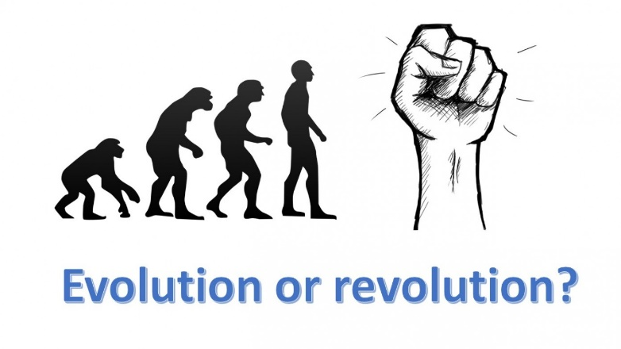
ICT enabled Innovation Spectrum
Digitization
(evolutionary)
Disruption
(Revolutionary)
Digitization of supply chain
No structural changes
Mainly three themes
Disintermediation
Uberization
Expert Systems – AI, ML and Big Data
Disintermediation and Uberization drive impact business transactions
Expert systems enable computers impacts human computer interaction – offers mass customization
Static digital
Content
Dynamic/
Interactive
Personalized/
Contextualized/
Insights Driven
Consumable Content/
Knowledge
Foundational for Decision Support
Systems (DSS)
On farm management tools possible only if this is available
IOTs
Plot level aerial imagery
Analytics
Personalization
Investment needed in making content dynamic and consumable – knowledge engineering

Slide 7
Why do Innovation and Entrepreneurship Matter?
Drivers of Prosperity
Innovation: The process of creating new goods and services that provide unique value for demanding customers who are willing to pay for that value
Entrepreneurship: The creation and growth of new businesses (start-ups per adult population)
I+E increase the rate of economic growth
Innovation
Entrepreneurship
“Knowledge-Based”
Entrepreneurs
Economic Growth
Time
“Invention and entrepreneurship are at the heart of national advantage”
- M. Porter
Innovation and entrepreneurship create prosperity by:
Increasing wages by competing on human capital and knowledge
Reducing unemployment
Connecting local economies to the global economy
Facilitating clusters and knowledge transfer
Source: Audretsch, D.B. and R. Thurik, “Linking Entrepreneurship to Growth,” OECD Science, Technology and Industry Working Papers, 2001/2

Slide 8
Innovation Definition
Problem
Recognition
Problem
solving
Invention
Solution
Exploitation
Innovation
Innovation pipeline

Slide 9
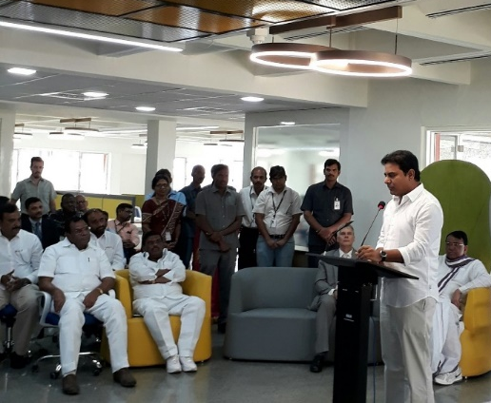
A new paradigm to do
digital agriculture
Agri-entrepreneurship can :
Attract youth to agriculture
Foster entrepreneurship spirit and help increase incomes
ICRISAT ihub launched on February 13, 2017 to accelerate opportunities for agri-preneurs in India
Notes:
KT Rama Rao, GVR Mohan Reddy, Chairman Cieyent
Dr Praveen Rao, Professor Jayashankar Telangana State Agriculture University

Slide 10
KALGUDI
TITSC
Intello Labs

Slide 11
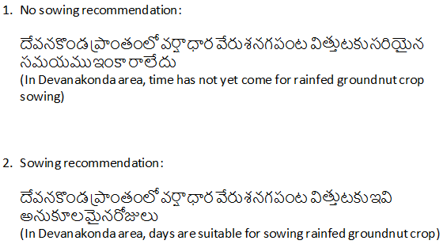
Decision tree – Rainfed groundnut system, Anantapur
Phase 1 (Sowing App)
Pilot in June 2016 focused only on Sowing date advisory in collaboration with Microsoft Hyderabad
This model projected the moisture adequacy index (MAI) using water balance technique based on weather forecast and outlook (IMD, IITM, aWhere).
MAI based logic used to trigger sowing date advisory to farmers.
Phase 2 (isat)
Timeline
Conditions
Decision
Message
The current experiment tries to contextualize the Long Term forecasts for small holder farmers
Pre-season advisory from IMD, IITM, EFRS is being used to send season advisory
Great opportunity to build such systems for more crops and agro-ecologies and enable small holders for tactical management.
A good template for translating knowledge to actionable insights for farmers
April&May
Kharif
Avg Rain=352 mm
P for>350 mm=0.44
Plant GN with PP as intercrop
Any other options??
Plant GN at the earliest opportunity after 2nd week of June
Plough the land, prepare the seed and apply FYM
LT Forecast
AN
>350 mm
BN
<350 mm
Plant early maturing GN at the earliest opportunity
Plough the land, get the seed
Consider using a mix of crops
Prepare for planting a mix of crops
No
El Nino
Yes, Av RF=265 mm
Plant early maturing GN at the earliest opportunity
Plough the land, get the seed
Consider allocating about 25-50% of the land to drought tolerant crops-Early maturing PP, Foxtail etc
Limited GN with high proportion of drought tolerant crops
Notes:
1. Sustaining and enhancing ICRISAT’s research programs and impacts in SSA
2. Promoting biotechnology products in Asia and SSA
3. Fortifying conventional and innovative resource mobilization strategies
4. Leading the Future Harvest Alliance Executive
5. Optimizing opportunities in ICT and e-learning
6. Communicating successes and impacts

Slide 12
Timeline
Conditions
Message
<10 mm
2week outlook
BN
Wait
Next week forecast
<10 mm
AN
Met Weeks | Date
23 | 4 - 10 Jun
24 | 11 - 17 Jun
25 | 18 - 24 Jun
26 | 24 Jun - 1 Jul
27 | 2 - 8 Jul
28 | 9 - 15 Jul
29 | 16 - 22 Jul
30 | 23 - 29 Jul
31 | 30 Jul - 5 Aug
32 | 6 Aug - 12 Aug
33 | 13 Aug - 19 Aug
34 | 20 Aug - 26 Aug
35 | 27 Aug - 2 Sep
36 | 3 Sep - 9 Sep
37 | 10 Sep - 16 Sep
38 | 17 Sep - 23 Sep
39 | 24 Sep - 30 Sep
40 | 1 - 7 Oct
Week 1
Last week Rain
>10 mm
2week outlook
Prepare the land
<10 mm
2week outlook
BN
>10 mm
Next week forecast
Wait
>10 mm
2week outlook
AN
Prepare the land
June
Avg Rain=50 mm
P for>20 mm=0.73
<10 mm
2week outlook
BN
Wait
Next week forecast
<10 mm
>10 mm
2week outlook
AN
Prepare the land or Plant GN
Last week Rain
Week 2
2week outlook
BN
Prepare land
Next week forecast
<10 mm
>10 mm
AN
>10 mm
2week outlook
Get ready for planting
2week outlook
BN
Next week forecast
<10 mm
Prepare land
Week 3
<10 mm
2week outlook
AN
Plant GN
Last week Rain
>10 mm
2week outlook
BN
Wait
Next week forecast
<10 mm
>10 mm
>10 mm
2week outlook
AN
Plant GN
Week 4
<10 mm
2week outlook
BN
Next week forecast
Wait
<10 mm
2week outlook
AN
Last week Rain
>10 mm
Plant GN
2week outlook
BN
>10 mm
<10 mm
Wait
Next week forecast
AN
2week outlook
Plant GN
>10 mm
Notes:
1. Sustaining and enhancing ICRISAT’s research programs and impacts in SSA
2. Promoting biotechnology products in Asia and SSA
3. Fortifying conventional and innovative resource mobilization strategies
4. Leading the Future Harvest Alliance Executive
5. Optimizing opportunities in ICT and e-learning
6. Communicating successes and impacts

Slide 13
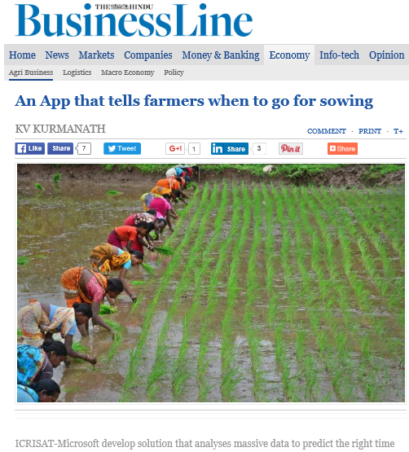
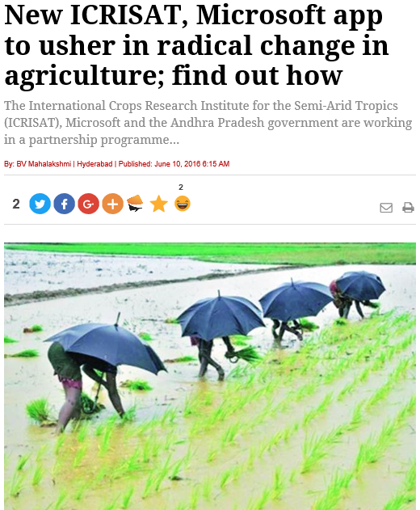
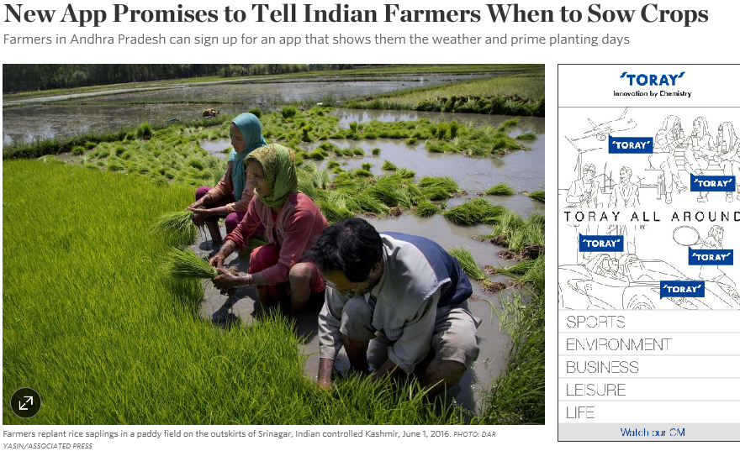
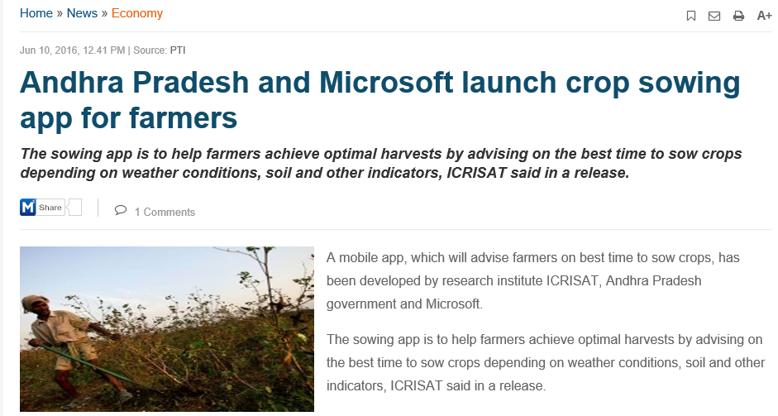
Notes:
Fundraising update - overview - new initiatives
Communications update - overview - new initiatives

Slide 14
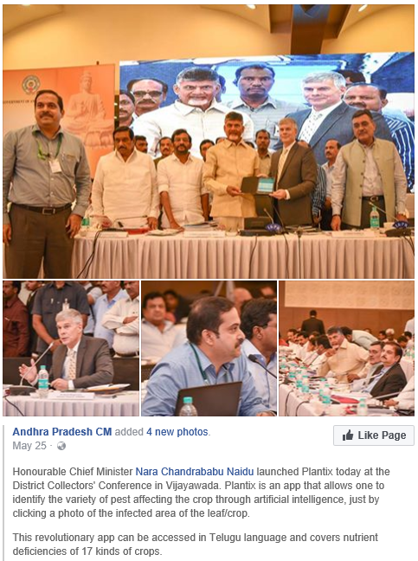
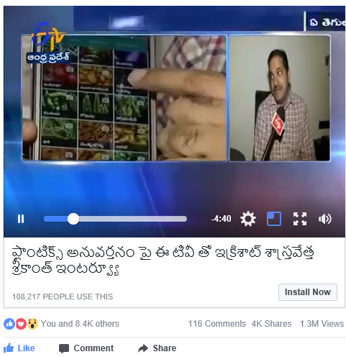
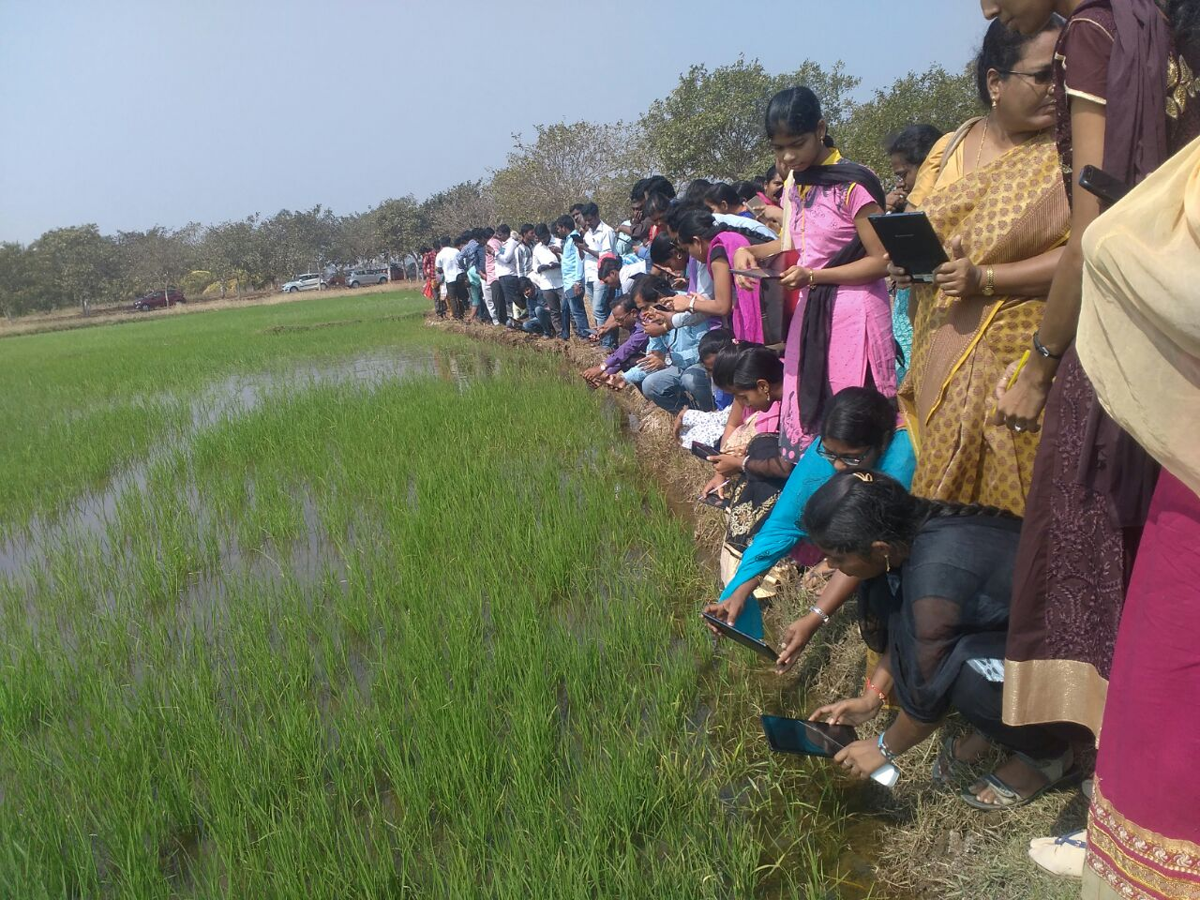
ICRISAT – PEAT Collaboration
Major partner on the ground
Picture Acquisition
Networking
Governments &
University
PR & Marketing
Farmer
Workshops

Slide 15
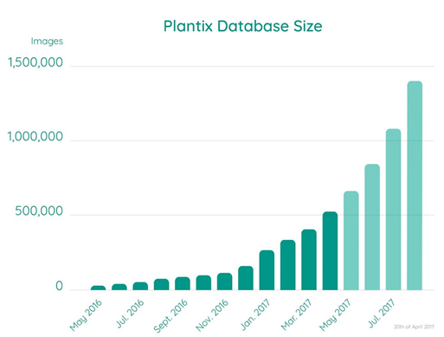
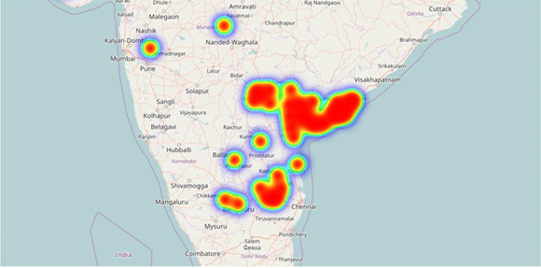
ICRISAT – PEAT Collaboration
From about 10 k downloads in November 2016 to the present range of 100 k is a big leap due to our intervention
ICRISAT & PEAT will continue to collaborate to add more crops and pest & diseases to the library
ICRISAT will pursue plantix adoption with govts and farmers
PEAT, ICRISAT, CIMMYT consortium proposes to undertake pest/disease modelling which currently suffers from absence of high quality primary data

Slide 16
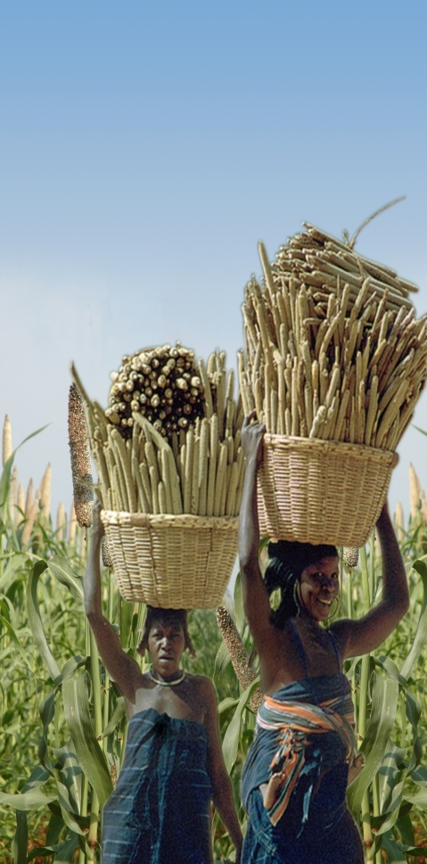
Thank You

Slide 17
Various Contexts of Agriculture
Agriculture
Farming
Knowledge
Commerce

